Slide 1

Getting Started
An Introduction to
IBISWorld Industry Research

Slide 2
WWW.IBISWORLD.CO.UK
IBISWorld Reports
IBISWorld industry reports are powerful business tools that provide strategic insights and analysis on over 400 UK SIC industries. We publish the UK’s most comprehensive selection of reports, at the class level of UK SIC – everything from Hard Coal Mining to Pubs & Bars.
Extensive, objective and easy to digest, IBISWorld’s industry reports offer the very latest content on almost every UK industry. The reports are updated between 1-4 times a year which is depending on how fast moving the industry is.
Each report consists of 25 to 30 pages of key statistics and analysis on;
  Market Characteristics ie. Revenue
  Operating Conditions
  Current and Historical Performance
  Five-year Forecasts on Revenue
  Imports and Exports
  Employment, Enterprises and other Key Statistics
  Major Industry Participants with Market Share and more

Slide 3
WWW.IBISWORLD.CO.UK
IBISWorld Access
You are have access to IBISWorld Industry Intelligence Service through your University VLE.
Clicking the link on your VLE takes you straight to the resource you don’t need to sign in or remember any passwords.
You can also login automatically if you go onto www.ibisworld.co.uk on campus.
Reports available are:
  400+ UK Industry Reports
  700+ US Industry Reports
  250+ China Industry Reports

Slide 4
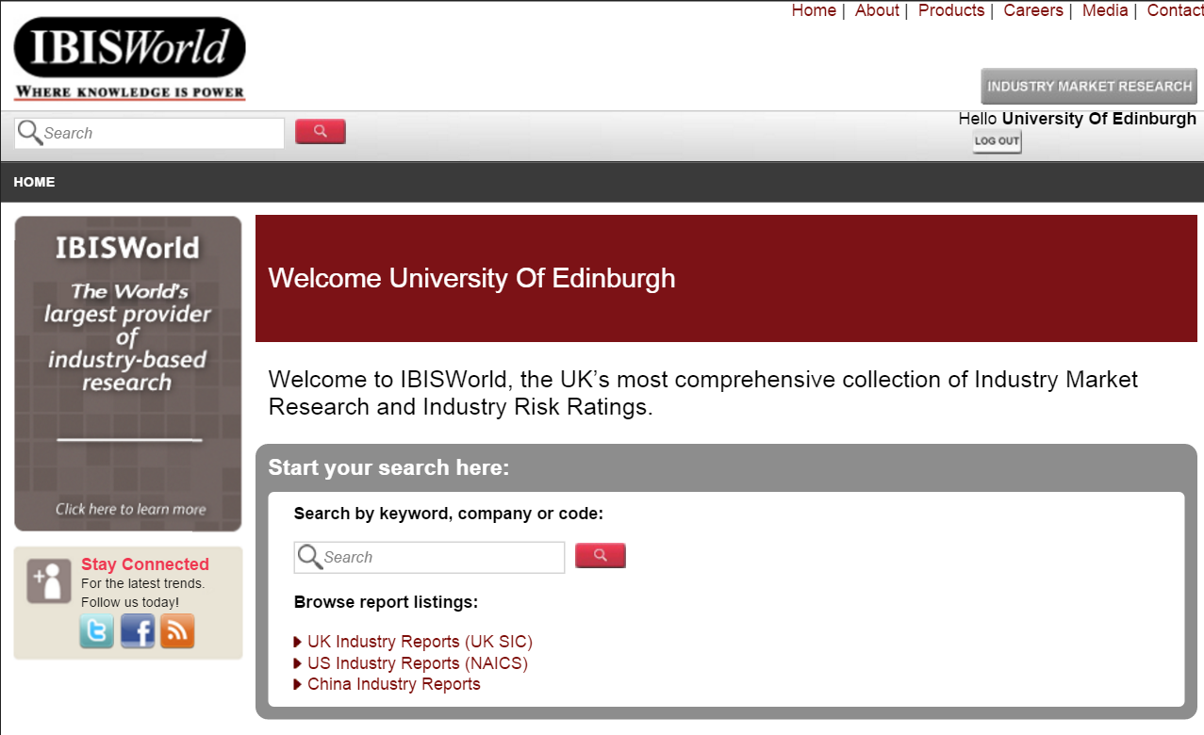
WWW.IBISWORLD.CO.UK
Navigating the IBISWorld Website
  Select your report type…
UK, US or China Industry Reports

Slide 5
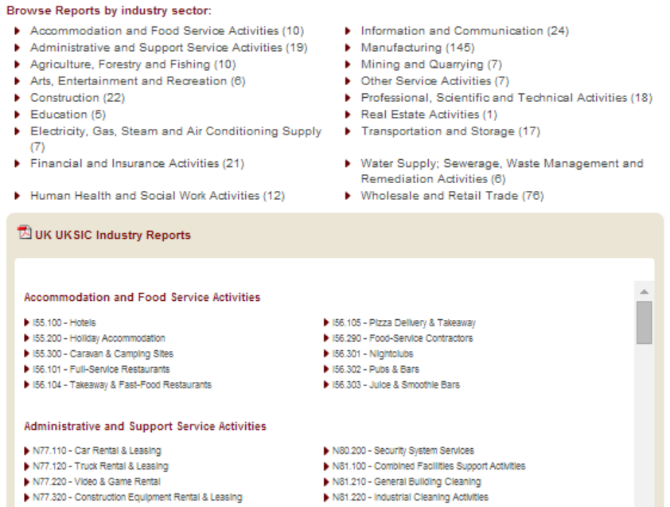
WWW.IBISWORLD.CO.UK
Navigating the IBISWorld Website
  You can browse by sector
  or
  scroll down to view
  a full list of our reports

Slide 6
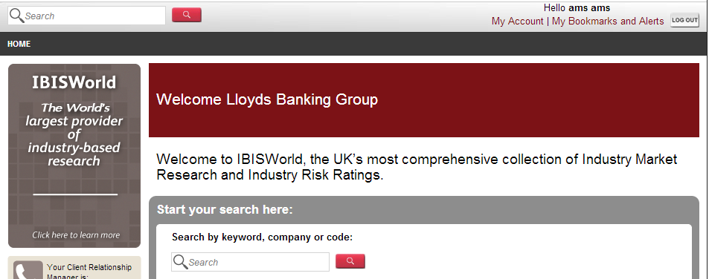
WWW.IBISWORLD.CO.UK
Locating a Report
Keyword Search… If you know exactly what you are looking for, simply enter your search criteria into one of the search boxes and click on .
Welcome University of Edinburgh

Slide 7
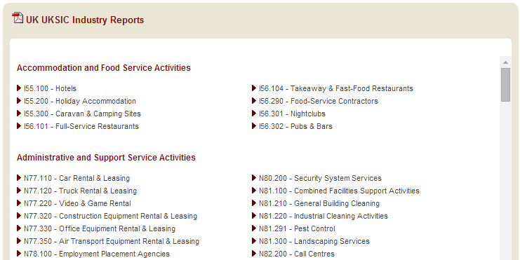
WWW.IBISWORLD.CO.UK
Viewing a Report
To view the full report, simply click on the hyperlink.

Slide 8
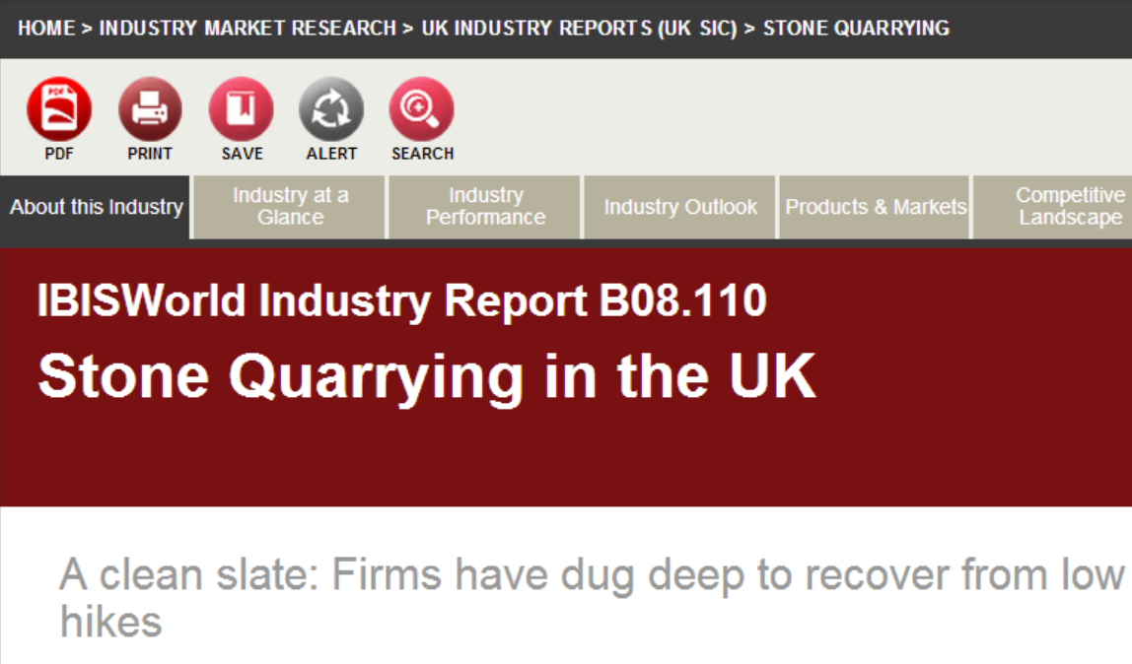

WWW.IBISWORLD.CO.UK
Navigating a Report
PDF Download
Print Chapter
Bookmark for Later
Add and Email Alert for Updates
Search within Report

Slide 9

WWW.IBISWORLD.CO.UK
Chapters
The first two chapters, About this Industry and Industry at a Glance, give an overview of the report which is explained in more depth later in the relevant chapters.
Each report has the same structure so you can compare the same chapter/sub-chapter for multiple industry.

Slide 10
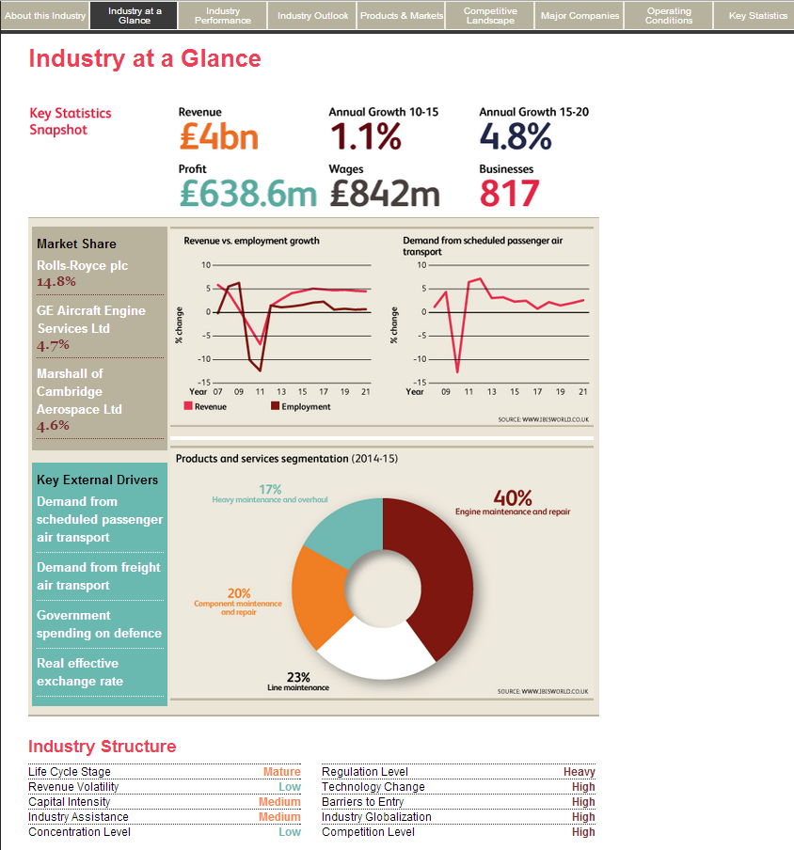
WWW.IBISWORLD.CO.UK
For a snapshot of the Industry Report use the Industry at a Glance Chapter which gives a quick overview of the information contained in the report:
Key Statistics
Levels & Trends
Executive Summary
Key External Drivers
Major Players

Slide 11
Lindsay Harris
E: lindsayah@ibisworld.com
T: 44 (0) 20 7654 6816

